Slide 1
ASL VIDEO TO TEXT (Hand Gesture Translation)
project group 5

Slide 2
Fundamental tool of the model
What makes the model special?
What is our model?
Basic structure of model

Slide 3
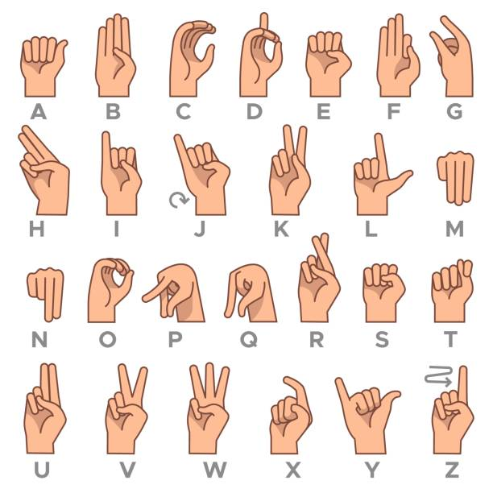
What is our model?
Video of several ASL characters
ASL : American Sign Language
Translated text

Slide 4
What makes the model special?
Static / Dynamic feature of ASL alphabets
ASL representation of J and Z includes dynamic gesture
Other alphabets(excluding J and Z) are represented by static gesture
Handle static and dynamic sign characters simultaneously
Most CNN-based open-source sign language detection models only deal with static characters
Models for dynamic sign languages are often too complicated or have limited coverage
Can handle sequence of ASL alphabets inside a video
A lot of models for sign language detection gets image input

Slide 5
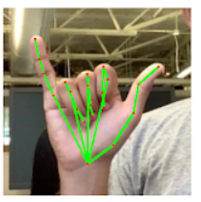
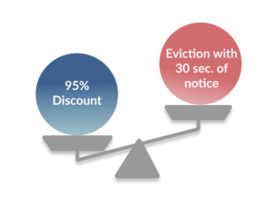
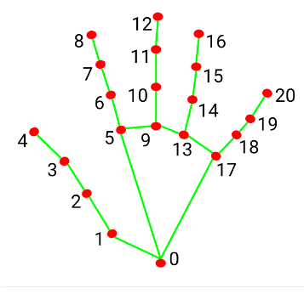
Spot virtual machine
Fundamental tool of the model
Mediapipe
open source code for motion capture, object detection from Google
Media pipe hands solution is for hand detection
It detects 21 points in hand it’s x, y, z coordinate
(Main point to argue)
Can be evicted any time(not predictable)
Gives warning 30 second before eviction

Slide 6
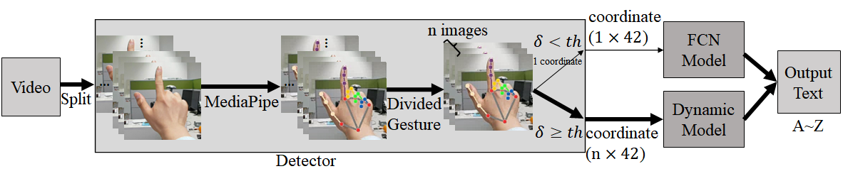
ㅠㅠt virtual machine
Basic structure of the model

Slide 7
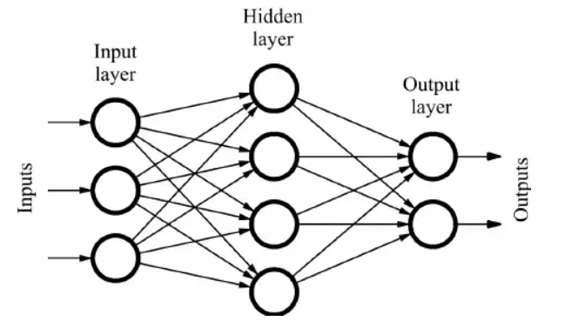
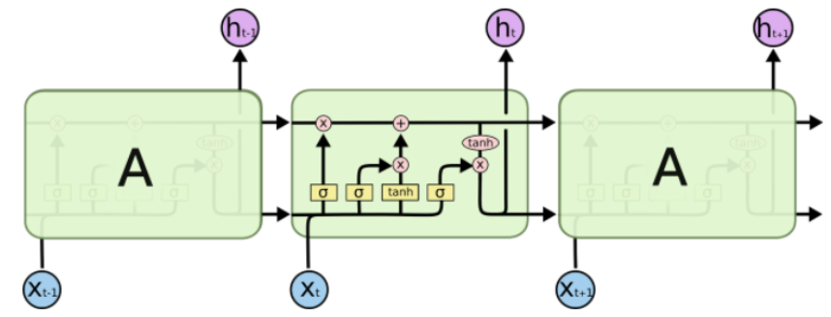
ㅠㅠt virtual machine
Basic structure of the model
Static Classifier
Dynamic Classifier

Slide 8

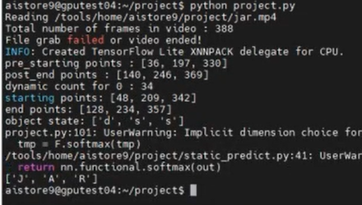
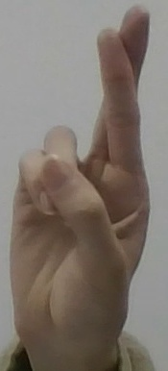
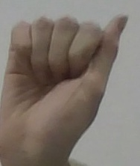
Results
J
A
R

Slide 9
References
Hands | mediapipe (google.github.io)
[Deep Learning] Hand gesture recognition | by Yacine BENAFFANE | Becoming Human: Artificial
Real-Time Hand Gesture Recognition Based on Deep Learning -Journal of Korea Multimedia Society (koreascience.kr)

